Slide 1
Post processing after segmentation
CRF、CRFASRNN、Bilateral Solver

Slide 2
Post processing after segmentation
CRF
CRFASRNN
Bilateral Solver
Fast Gaussian filtering

Slide 3
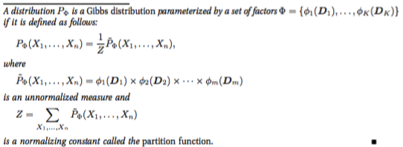
MRF
Markov Random field
Gibbs distribution

Slide 4
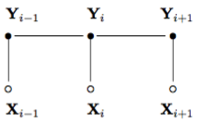
CRF
Chain-structured CRF

Slide 5
CRF
A random field X:{X1, …, XN} belongs to labels L = {l1, …, lk}
A random field I: {I1, …, IN} stands for pixels.
Clique: c
Gibbs distribution
stands for the conditional random field (I,X)
MAP labeling

Slide 6

Fully connected CRF
Gibbs Energy
Fully connected pairwise CRF
Gibbs energy
Unary potentials:
generated from neutral network as prior
No parameters

Slide 7




Fully connected CRF
Pairwise potentials:
Appearance kernel
Smoothness kernel

Slide 8


Inference
The Gibbs distribution
Z is intractable
Mean field approximation
The potential distribution

Slide 9
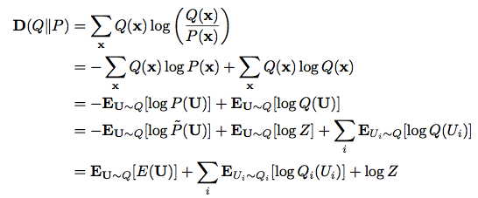
Inference
Minimize the KL-divergence

Slide 10

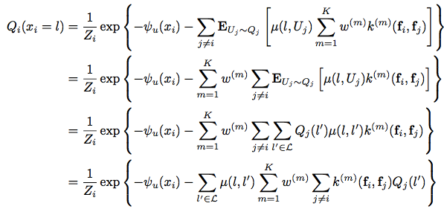
Inference
Update equation (Z -> Zi is tractable)

Slide 11
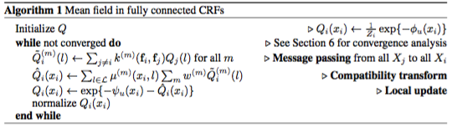
Inference
Mean field in fully connected CRFs
Message passing
Quadratic complexity

Slide 12

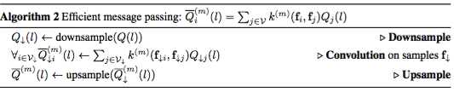
Inference
Efficient Message Passing Using High-Dimensional Filtering
Splat → blur → slice

Slide 13

Learning
Learning Parameters
Grid search
Setting
MLE
simple label given by the Potts model (for Deeplab v2)
Objective function of MLE

Slide 14
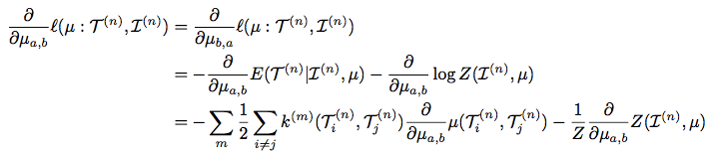
Learning
Gradient of L
Z is intractable again
Use potential distribution Q again

Slide 15
CRF
Conclusion
Modeling
Unary potentials
generated from neutral network as prior
Pairwise potential
Smoothness kernel
Encourage label agreement between similar pixels
Appearance kernel
Spatial and appearance consistency
Training and Inference intractable
Message passing → Gauss filtering → BSB
Partition function in Gibbs distribution is intractable
minimize KL(Gibbs distribution | potential distribution)

Slide 16
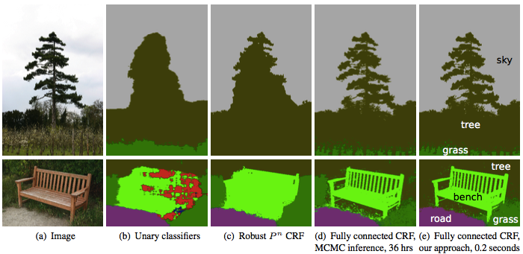
CRF

Slide 17
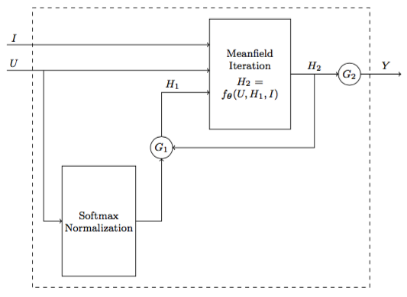
CRFASRNN
CRF as unrolled RNN

Slide 18
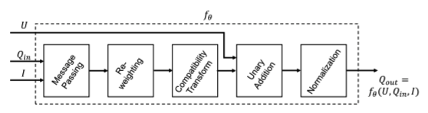
CRFASRNN
Mean field iteration

Slide 19
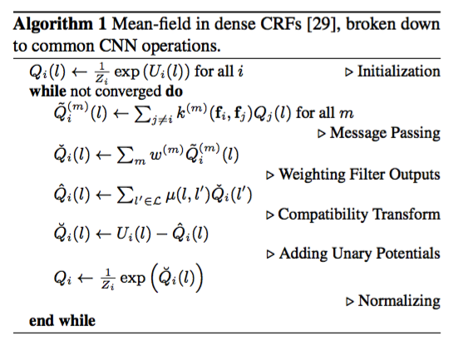
CRFASRNN
Mean field iteration

Slide 20
CRFASRNN
Initialization (softmax)

Slide 21
CRFASRNN
Message passing(custom layer)
Permutohedral lattice(O(N^2) → O(N))
Splatting
Blur
Slicing

Slide 22
CRFASRNN
Reweighting(1x1 conv)
Weighted sum of 2 Gauss filters
Spatial kernel (Smoothness kernel)
Bilateral kernel (Appearance kernel)
Independent kernel weights for each class label
Bicycle
TV

Slide 23
CRFASRNN
Compatibility Transform(1x1 conv)
The Potts model
Different penalty on different pairwise classes
Person vs bicycle
Sky vs bicycle

Slide 24
CRFASRNN
Unary addition(add op)
Unary input
Pairwise input
Normalization(softmax)
Iteration
Unrolled RNN
Weights sharing

Slide 25
CRFASRNN
Conclusion (compared with CRF)
Accuracy improved (IOU(%): 72.96 vs 67.64)
Speed Slowed down (time(ms): 2214 vs 918)
Learnable parameters
CRF in deeplab v2 has no learnable variable

Slide 26
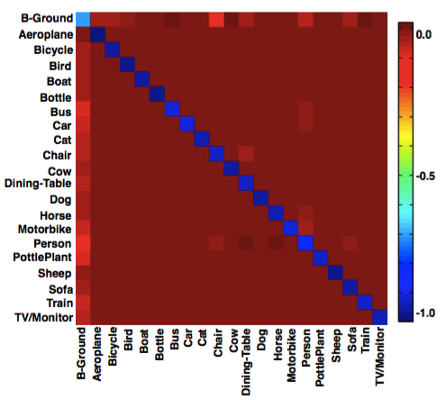
CRFASRNN

Slide 27


Bilateral Solver
Goal: recover an “output” vector x(Figure1b), which is resemble the input target where the confidence is large while being smooth and tightly aligned to edges in the reference image.
t : the “target” value, Figure1a
c : the quantities, Figure1c
Spatial position, color: reference image, Figure1d

Slide 28
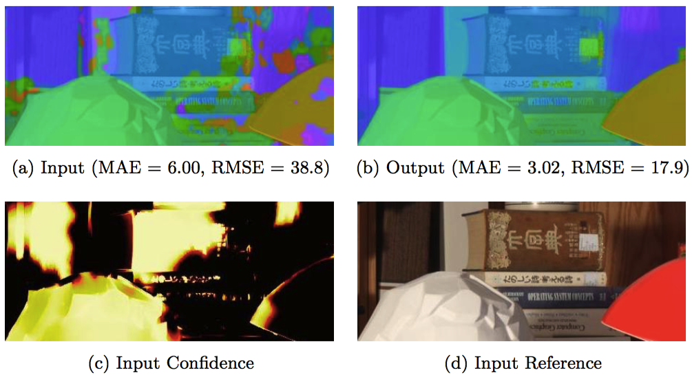
Bilateral Solver

Slide 29
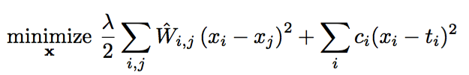
Formulation
Objective function:
Image-independent smoothness term that encourages x to be bilateral-smooth
A data-fidelity term that minimizes the squared residual between x and the target t weighted by confidence c

Slide 30

Formulation
Bilateral affinity matrix W
Techniques for speeding up bilateral filtering

Slide 31
Formulation
A “simplified” bilateral grid
A technique for producing bi-stochastization matrices Dn, Dm

Slide 32


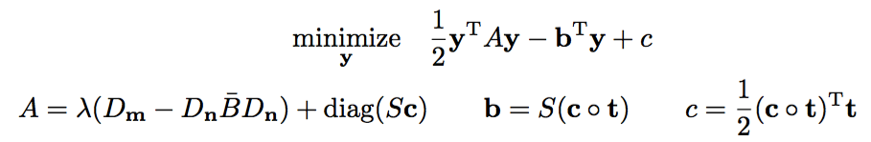
Formulation
Reformulate a high-dimensional pixel-space optimization problem in terms of the lower-dimensional bilateral-space vertices

Slide 33



Formulation
Minimizing the quadratic form
Equivalent to solving a sparse linear system
Slicing low-dimensional solution to high dimension

Slide 34




Back-propagation
Solving a linear system
Least squares problem
Back-propagate onto A and b (assume that we have computed the estimated vector and its gradient )

Slide 35



Back-propagation
A is symmetric and positive definite
Gradient on diagonal of A will be more efficient
From matrix product to Hadamard product

Slide 36



Back-propagation
Recall the formulation
Assume that we have computed some loss and its gradient

Slide 37




Back-propagation
Gradients

Slide 38
Back-propagation
Review
Forward
Backward

Slide 39



Preconditioning&Initialize
Jacobi preconditioner
Initialize the state vector y
Minimize the data term in the loss

Slide 40


Preconditioning&Initialize
Pyramid preconditioning
Construct a pyramid-space vector z from a bilateral-space vector y
Collapse z down to y

Slide 41



Preconditioning&Initialize
Pyramid preconditioning
Ad-hot element-wise scaling
Parameters for pyramid preconditioning

Slide 42


Preconditioning&Initialize
Pyramid initialization
Parameters for pyramid initialization

Slide 43
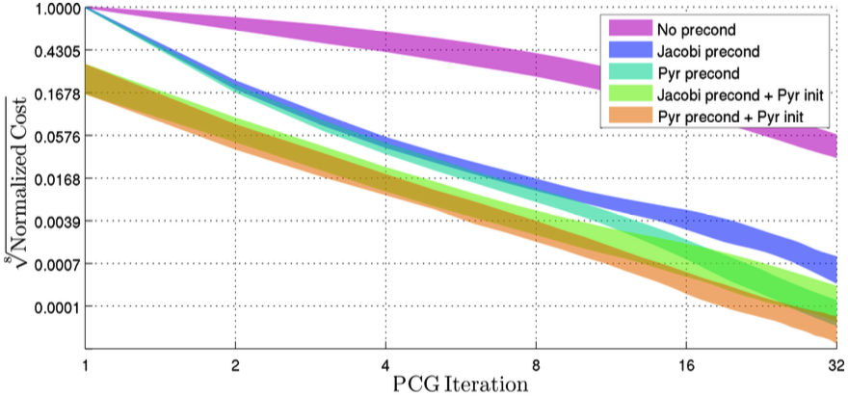
Preconditioning&Initialize

Slide 44
Bilateral Solver
Conclusion
Linear least-squares optimization problem
Simplified bilateral grid acceleration
Preconditioning acceleration
Initialization acceleration

Slide 45
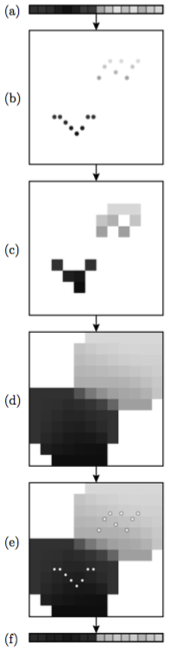
Fast Gaussian filtering
Splat or resample the input data onto the chosen sampling of position-space
Blur across this sampling, to mix together values with similar positions
Slice or resample back onto the original position vectors

Slide 46
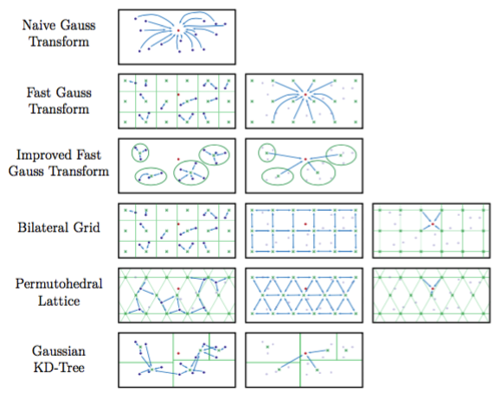
Fast Gaussian filtering
sd

Slide 47
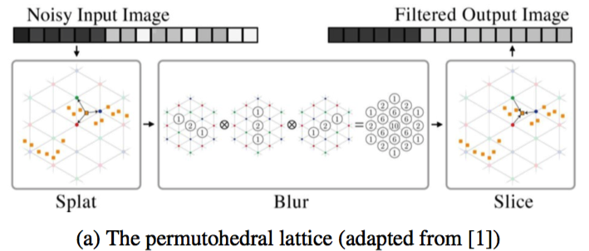
Fast Gaussian filtering
Permutohedral lattice

Slide 48
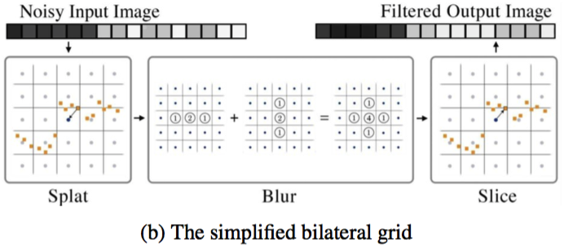
Fast Gaussian filtering
Simplified bilateral grid

Slide 49
Reference
DeepLab: Semantic Image Segmentation with Deep Convolutional Nets, Atrous Convolution, and Fully Connected CRFs
Conditional Random Fields- Probabilistic Models for Segmenting and Labeling Sequence Data
Efficient Inference in Fully Connected CRFs with Gaussian Edge Potentials
Conditional Random Fields as Recurrent Neural Networks

Slide 50
Reference
The Fast Bilateral Solver
Fast Bilateral-Space Stereo for Synthetic Defocus
Fast High-Dimensional Filtering Using the Permutohedral Lattice
HIGH-DIMENSIONAL GAUSSIAN FILTERING FOR COMPUTATIONAL PHOTOGRAPHY
A Fast Approximation of the Bilateral Filter using a Signal Processing Approach

